Slide 1


R-Ladies
Melbourne
Christmas party
7th December 2016
Please fill in our survey
See Twitter or Meetup page

Slide 2


Thanks to Zendesk!

Slide 3


















Thanks to Our Sponsors!
Data Science Meetup
and its sponsors

Slide 4
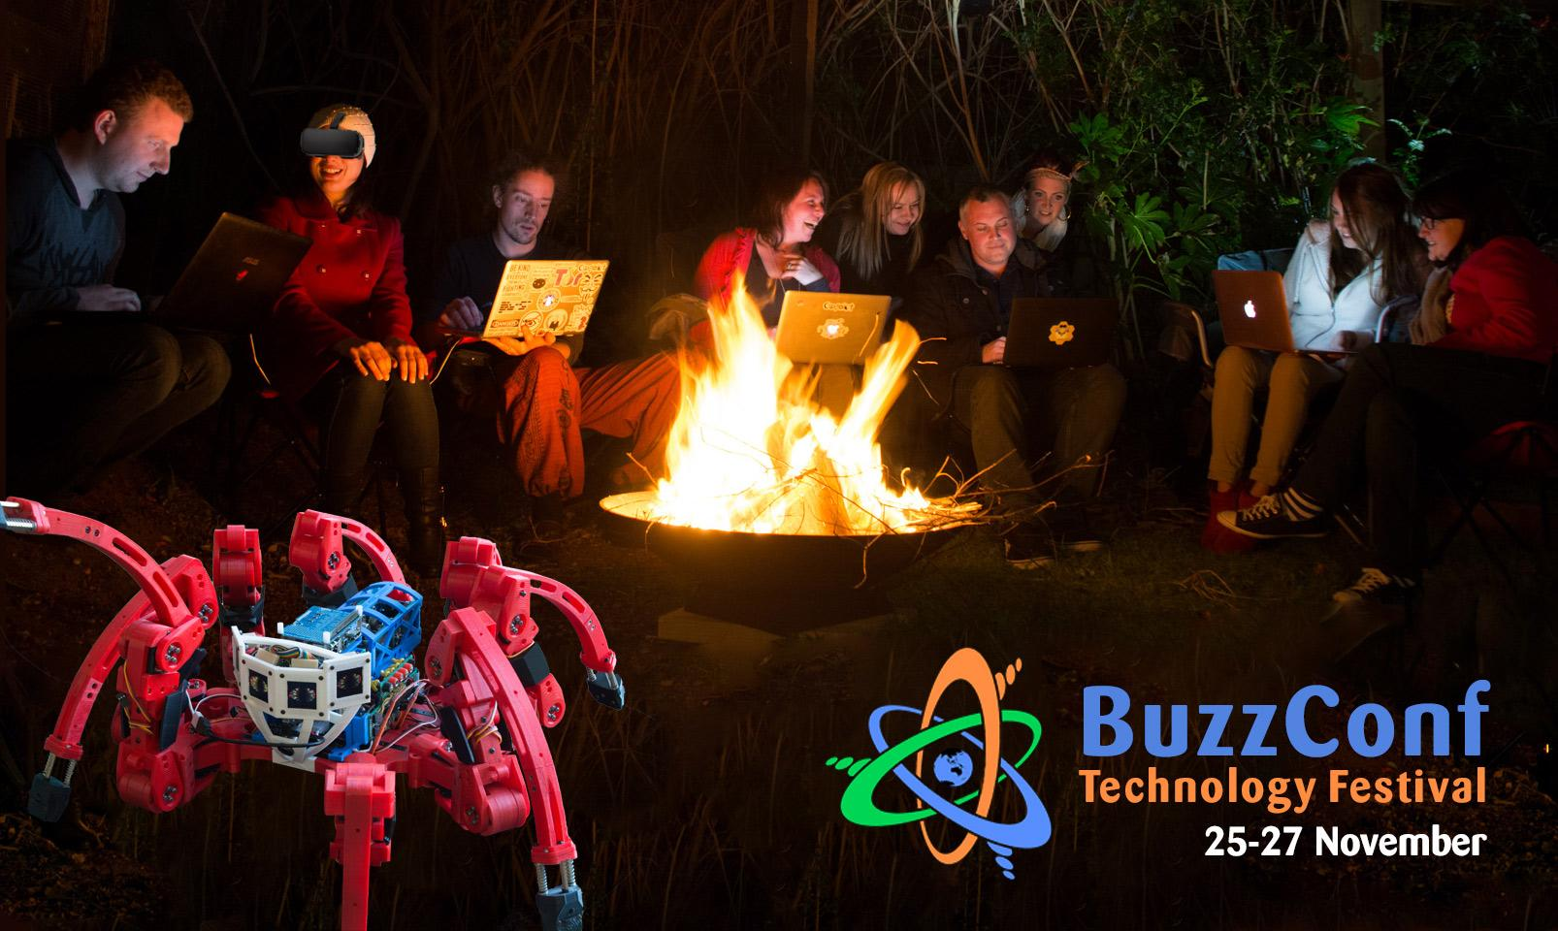

Thanks to BuzzConf!

Slide 5
The world’s
first and greatest
R-Trivia

Slide 6
Round 1

Slide 7
Round 1 - R facts
Name two people that invented the S programming language, the predecessor of R?

Slide 8
Round 1 - R facts
2. What does CRAN stands for?

Slide 9
Round 1 - R facts
3. How many CRAN mirrors are there for Australia?

Slide 10
Round 1 - R facts
4. Who is the author of Advanced R & R Packages books?

Slide 11
Round 1 - R facts
5. Where is the next UseR (UseR! 2017) conference going to be held?

Slide 12
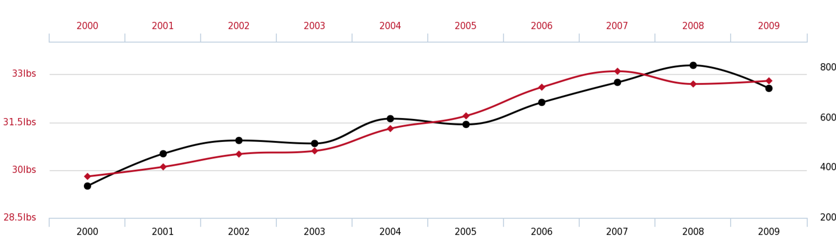
Bonus! Guess the lines!
Red line
Cheese consumed
Crop yield
Gold extracted
Black line
Population size
Bedsheet tanglings
USA Submarines produced

Slide 13
Did you know it…?
What do you think is behind this correlation?

Slide 14
Round 2

Slide 15
Round 2 - General R
What is the most popular CRAN package for data visualisation based on grammar of graphics?

Slide 16
Round 2 - General R
2. What is the expression that signals skipping the current iteration and going to the next iteration in a loop?

Slide 17
Round 2 - General R
3. What is the command set before generating random numbers that ensures reproducibility?

Slide 18
Round 2 - General R
4. Name at least one R package for Parallel programming/parallelization

Slide 19
Round 2 - General R
5. What is the the function that writes console output to a file?

Slide 20
Round 3

Slide 21
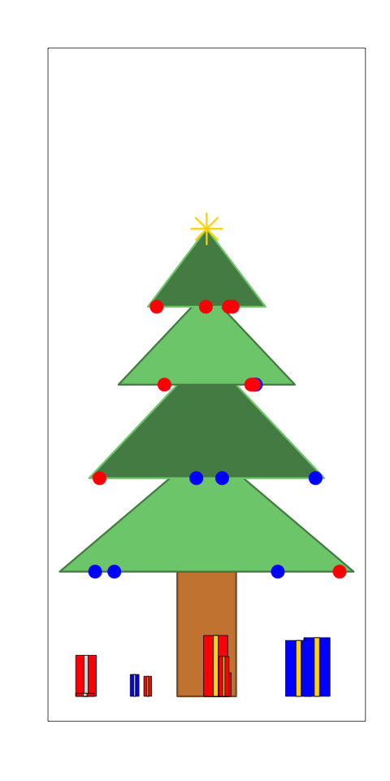
Round 3 - Visualisation in R
Which plotting functions have been used to produce the Christmas trees?
Notes:
https://gist.github.com/jtleek/4369771

Slide 22
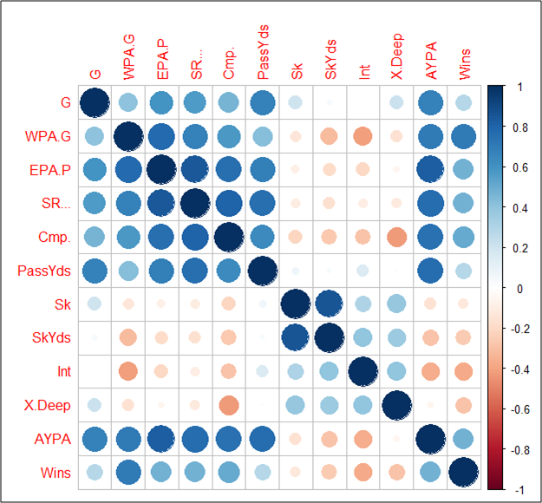
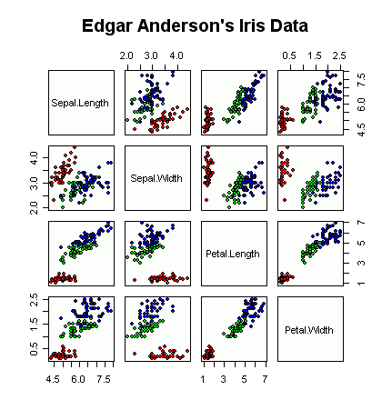
Round 3 - Visualisation in R
2. Which function made me?
corrplot()
b) pairs()
Notes:
https://gist.github.com/jtleek/4369771

Slide 23
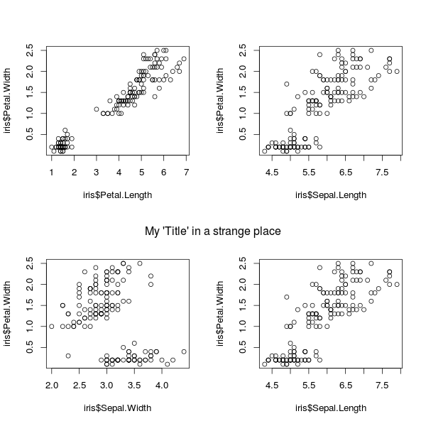
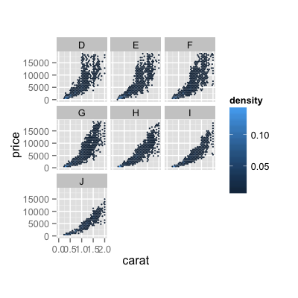
Round 3 - Visualisation in R
3. Which functions have been used to set plots on the same figure?
par()
b) facet_grid() facet_wrap()
base R
ggplot
Notes:
https://gist.github.com/jtleek/4369771

Slide 24
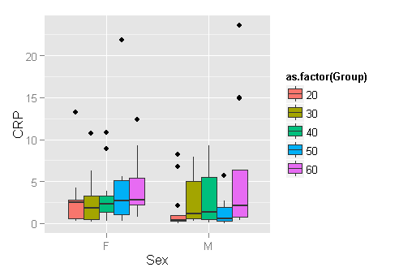
Round 3 - Visualisation in R
4. Which ggplot ‘geom’ am I ?

Slide 25
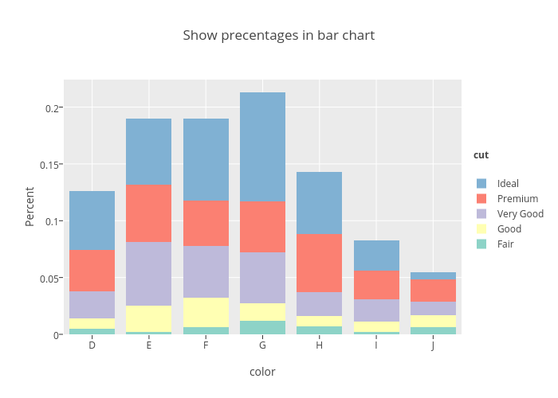
Round 3 - Visualisation in R
5. Which ggplot ‘geom_bar()’ am I ?

Slide 26
Bonus! Guess the correlation
http://guessthecorrelation.com/

Slide 27
Round 4

Slide 28
Round 4 - R and other systems
The Rstudio Service that facilitates interactive data analysis is:
a) Rstudio Server
b) Shiny
c) RMarkdown

Slide 29
Round 4 - R and other systems
2. What is the R package that allows R and C++ flawless integration?

Slide 30
Round 4 - R and other systems
3. State a file format for making dynamic documents with R

Slide 31
Round 4 - R and other systems
5. How can you install packages from CRAN and GitHub?

Slide 32
Round 4 - R and other systems
6. What is the function used to execute command-line/shell commands from within R?

Slide 33
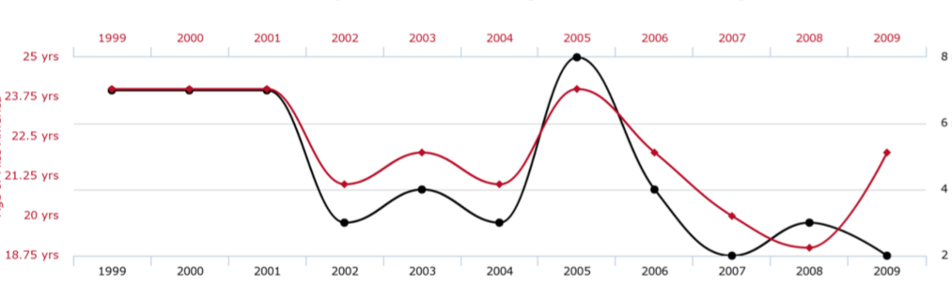
Bonus! Guess the lines!
Black line (integer)
Millions of new born in US
Games won by Chicago Bulls
Murders by steam
Red line (years)
US youngest surfer
Age of miss America
Average age at first child in Minnesota

Slide 34
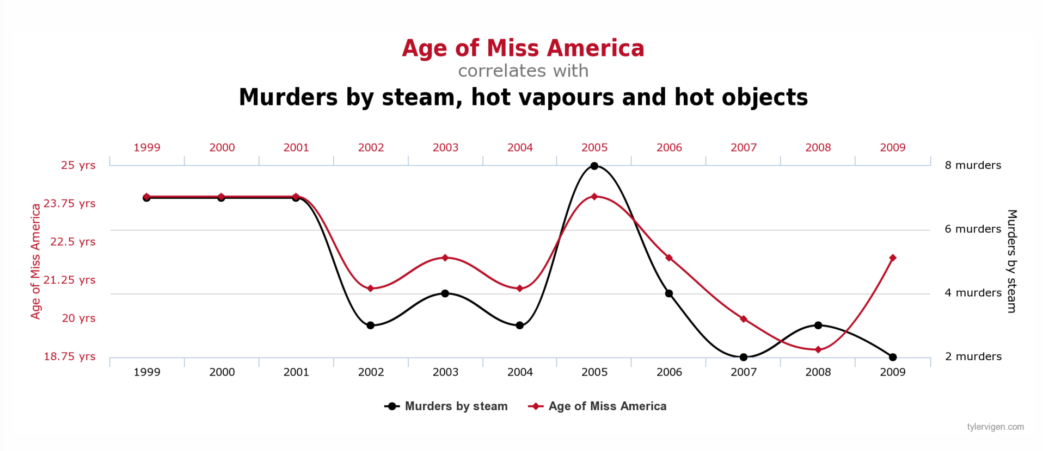
Did you know that…

Slide 35
Round 5

Slide 36
Round 5 - Functions
The command to check if all rows in a matrix/data frame have non-NA values?

Slide 37
Round 5 - Functions
2. Which code is more efficient when m is a matrix?
for (i in 1:ncol(m)) {
sum(m[ ,i]) }
apply(m, 2, sum)
colSums(m)

Slide 38
Round 5 - Functions
3. Name a function that lists files in a directory based on a pattern or a suffix

Slide 39
Round 5 - Functions
4. Which of the following commands return the indices of the matched patterns?
grep(pattern, x)
grep(pattern, x, value = TRUE)
grep(pattern, x, invert = TRUE)

Slide 40
End of rounds
That brings us to the end of R Trivia Night!
Don’t forget to
subscribe to our mailing list:
http://eepurl.com/cpgLmP

Slide 41


Check out PyLadies
http://melbourne.pyladies.com

Slide 42



Check out codelikeagirl!
www.codelikeagirl.com.au

Slide 43
Time for the raffle!
What is your name?
Where do you work and what do you do?
Why are you interested in R?
Why did you join R-Ladies Melbourne?
Anything about yourself you’d like to talk about?
Anything else?

Slide 44

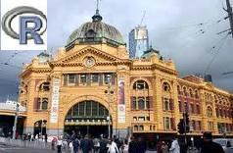
Thanks!
Melbourne Users of R Meetup

